Slide 1
A Chat on AutoML
Nic K

Slide 2
AutoML
Automated Machine Learning
Frank Hutter et al. (2019) Automated Machine Learning
Gaining huge popularity over the past 5 yrs with long time workshops in ICML, NIPS, ICLR, and now also in CVPR

Slide 3
What is AutoML?
Machine learning algorithms are hard to use
Not generally applicable to all tasks
Requires domain specific expert knowledge
What hyperparameters should we use?
What optimisers should we employ?
What architectures should be defined?

Slide 4
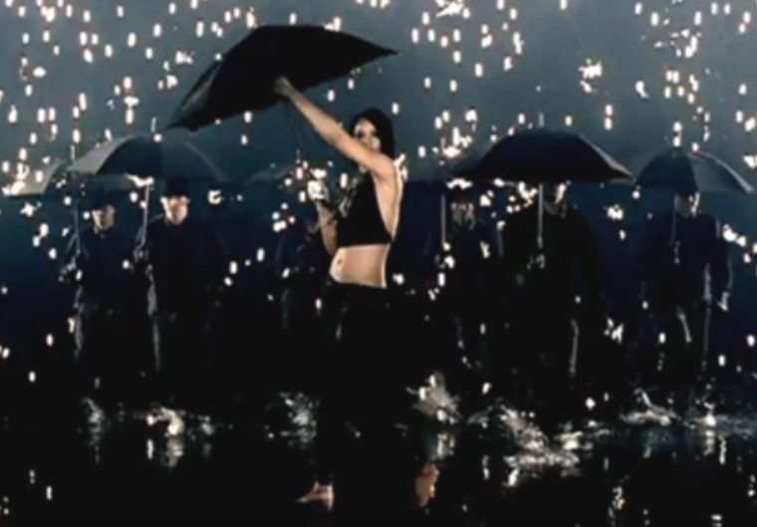
Types of AutoML
Transfer Learning Few-Shot Learning Zero-Shot Learning Meta-Learning Life-Long-Learning continual learning incremental learning
Neural Architectural Search

Slide 5
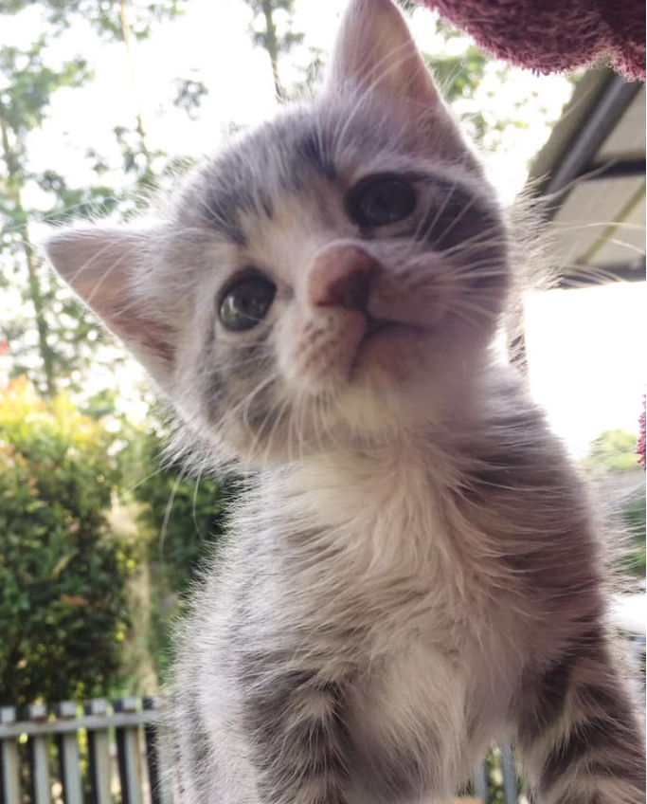
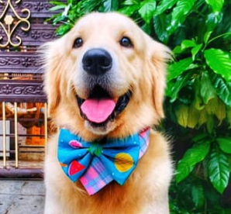
Questions so far?
Death battle, which one is cuter?
vs

Slide 6
About my work
Optimisation-based meta-learning
Train a neural network (the meta-learner) to prepare another neural network (the base learner)

Slide 7
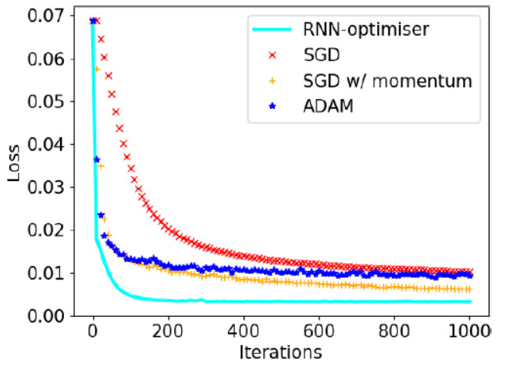
Benefits of a neural optimiser

Slide 8
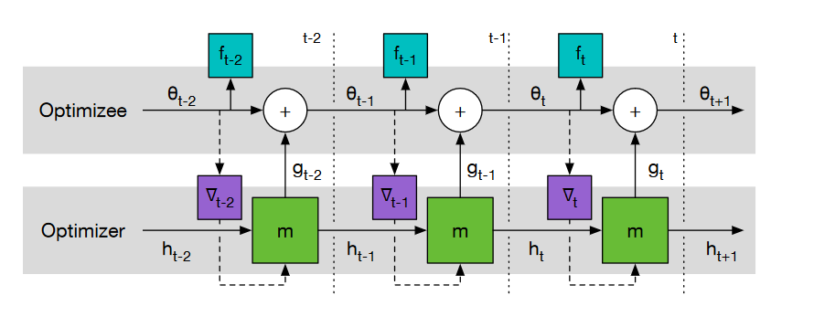
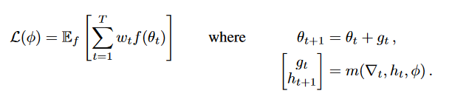
The experimental setup

Slide 9
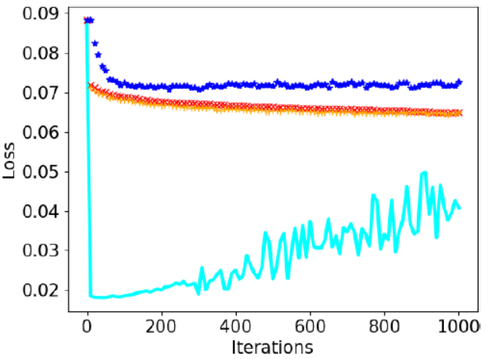
The problem

Slide 10
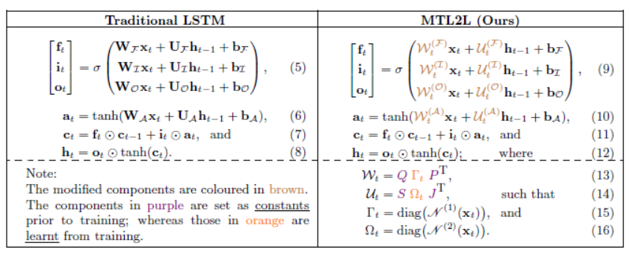
Awareness of input data

Slide 11
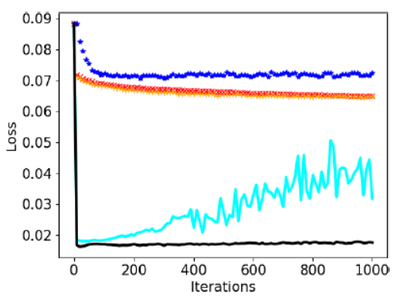
Results

